Slide 1

The Science of Keeping Food In Balance
Meredith Evans MS, RD, LD
May 20, 2021

Slide 2
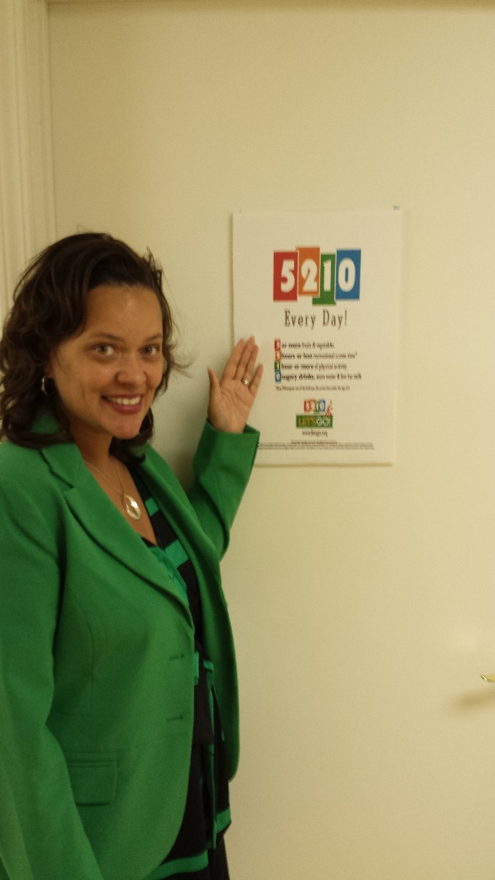
What is a Registered Dietitian?

Slide 3
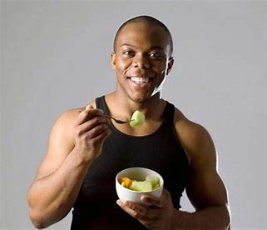
Overview
What is a balanced diet and what tools can I use?
Be aware of PORTION DISTORTION
Healthy Drinking
Physical Activity

Slide 4



Maintaining a healthy weight is a balancing act
Calories in
Calories out
Notes:
Food is more than just fuel. Your diet can help fight disease and keep you feeling younger. Your body needs energy to function and grow. Calories from food and drinks give you that energy. Think of food as energy to charge up your battery for the day. Throughout the day, you use energy from the battery to think and move, so you need to eat and drink to stay powered up. Balancing the energy that you take in through food and beverages with the energy you use for growth, activity, and daily living is called "energy balance." Energy balance may help you stay a healthy weight.

Slide 5


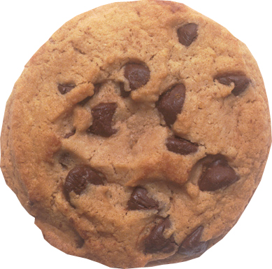
“A balanced diet is a cookie in each hand” ~Author unknown
Unfortunately … NOT!

Slide 6
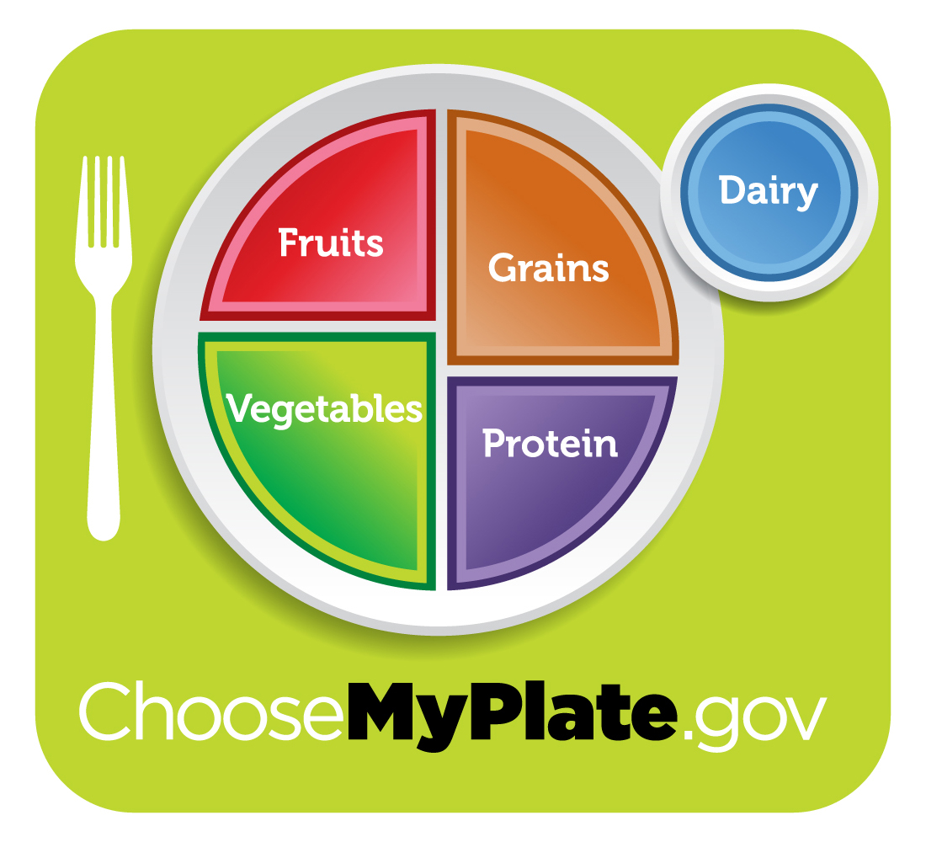
MyPlate gives guidelines for foods and amounts

Slide 7

Do you know what foods and what amounts are best for YOU?

Slide 8
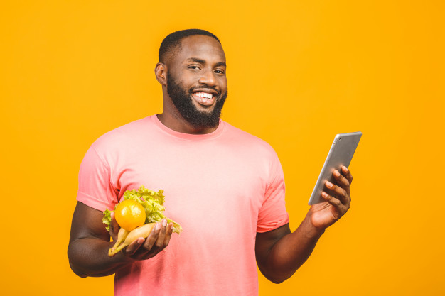
For a personalized plan for YOUR calorie level, based on age, gender, height/weight, and activity level — and for ages 2 through 18 — visit www.choosemyplate.gov/myplate/index.aspx

Slide 9
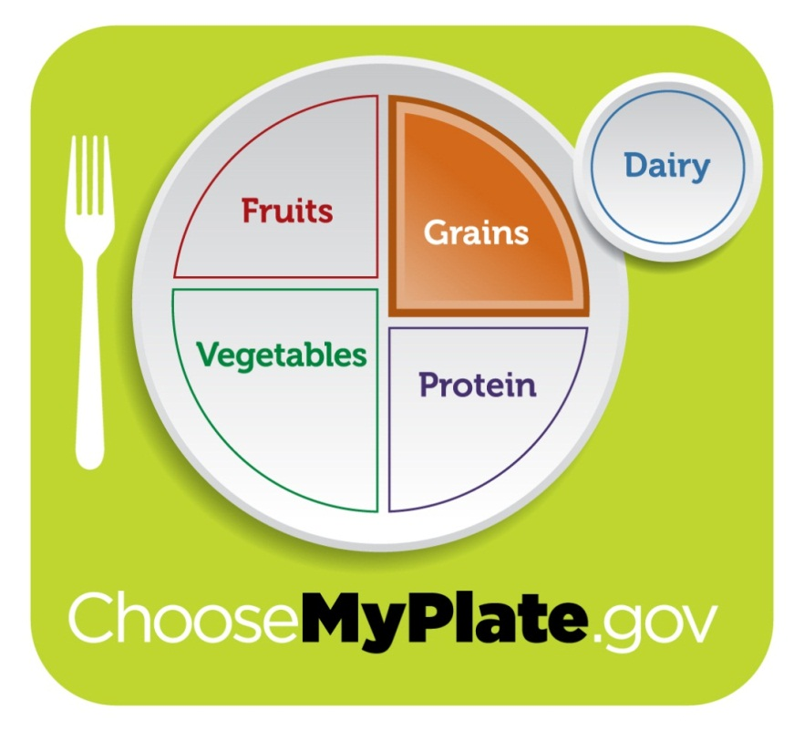
Grains
Eat 6 “ounce-
equivalents.” *
* Based on a 2,000 - calorie daily food pattern for ages 19 and over;
amounts may vary depending on your calorie needs

Slide 10
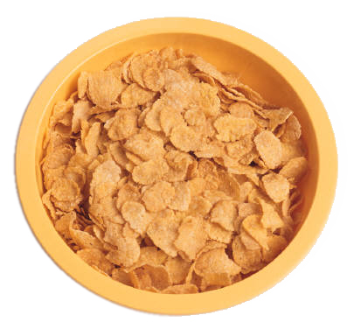
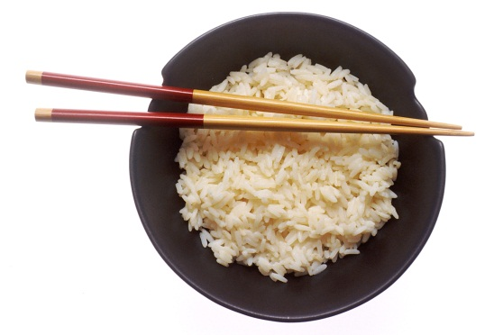
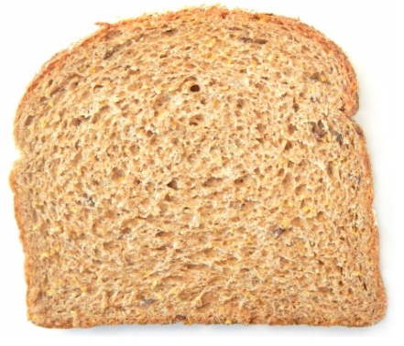
Grains
Ounce-equivalents:
1 slice bread
1 cup ready-to-eat
cereal (such as flakes)
½ cup cooked pasta,
cooked rice, or cooked cereal
Rice photo courtesy of National Cancer Institute / Renee Comet, Photographer

Slide 11
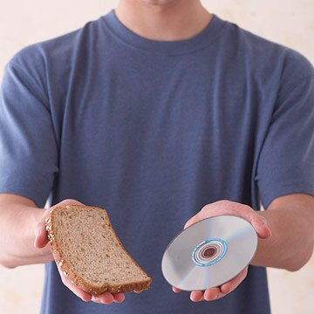
Bread Serving Size

Slide 12
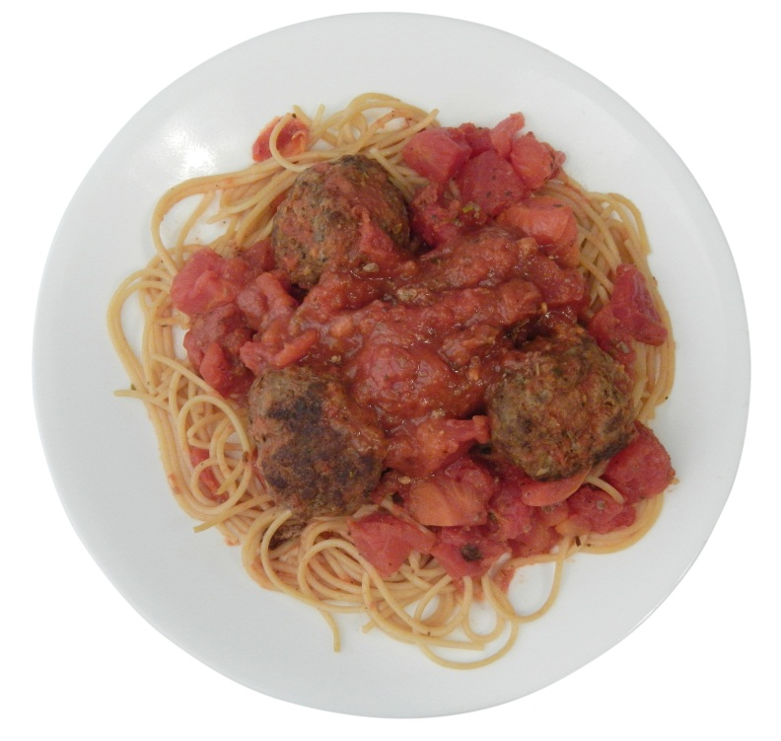
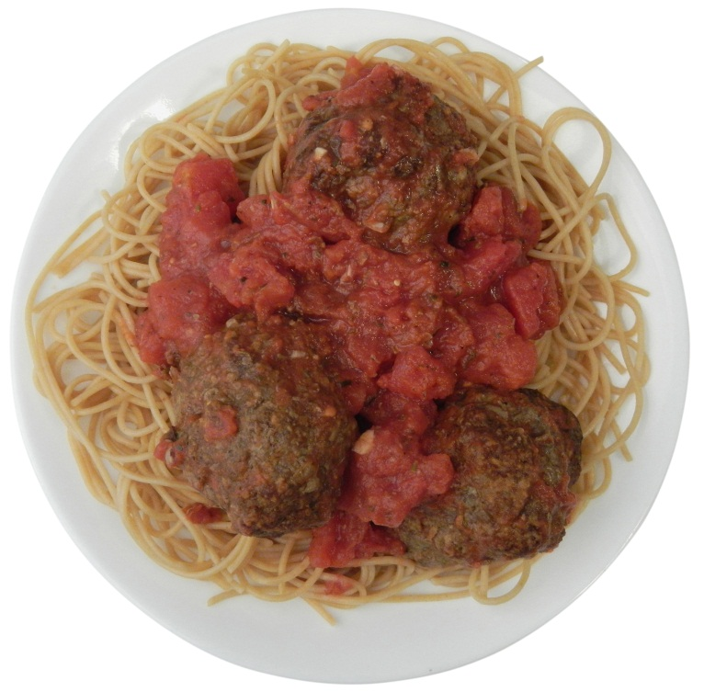
Guess the calorie difference!
20 Years Ago
Today
1 cups spaghetti
with sauce &
3 small meatballs
2 cups spaghetti
with sauce &
3 large meatballs

Slide 13
Guess the calorie difference!
500 calories
1,025 calories
525 more calories

Slide 14
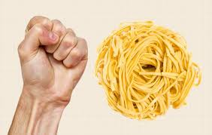
Portion size for 1 cup of pasta

Slide 15
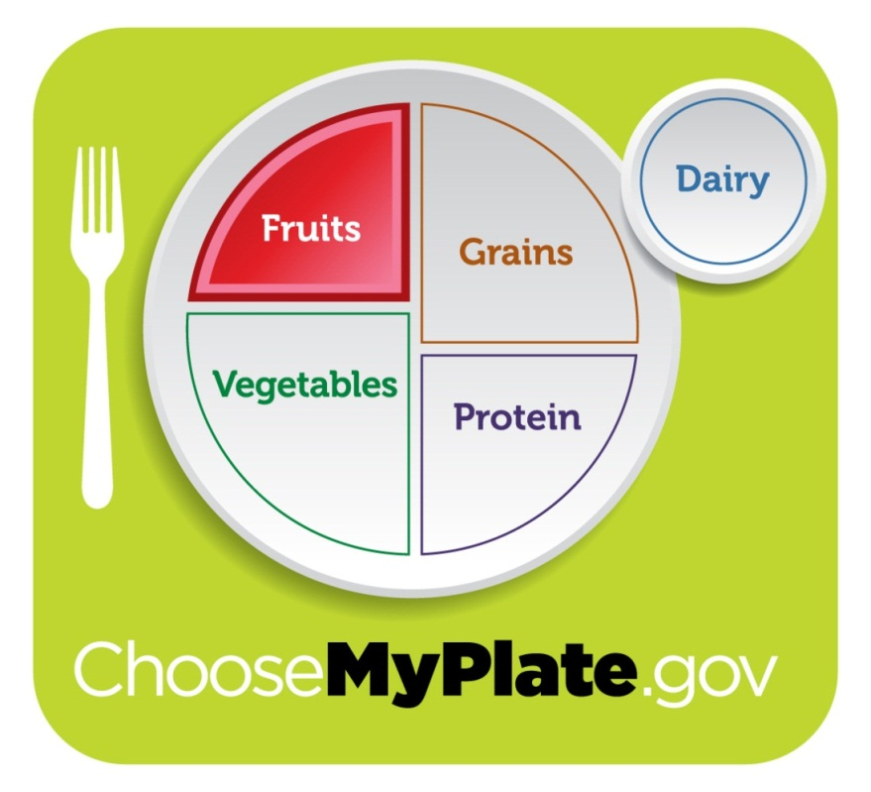
Fruits
Eat 2 cups of fresh, canned,
or frozen fruits.*
* Based on a 2,000 - calorie daily food pattern for ages 19 and over;
amounts may vary depending on your calorie needs
Notes:
Make half of your plate fruits and vegetables. Dark green, red, and orange vegetables have high levels of the nutrients you need, like vitamin C, calcium, and fiber. Adding tomato and spinach—or any other available greens that you like—to your sandwich is an easy way to get more veggies in your meal.

Slide 16
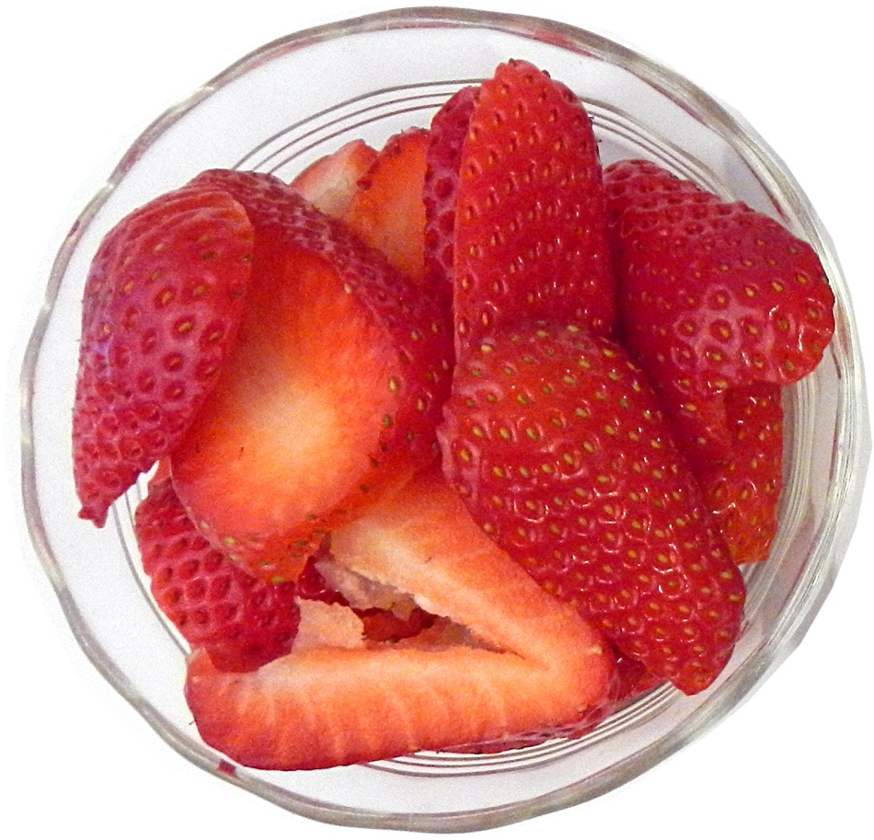
Fruits
1 cup fruit equals:
1 cup fruit
1 cup 100% fruit juice
½ cup dried fruit

Slide 17
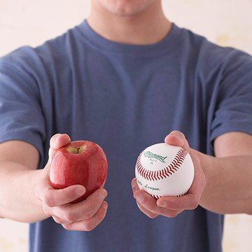
1 Cup of Fruit

Slide 18
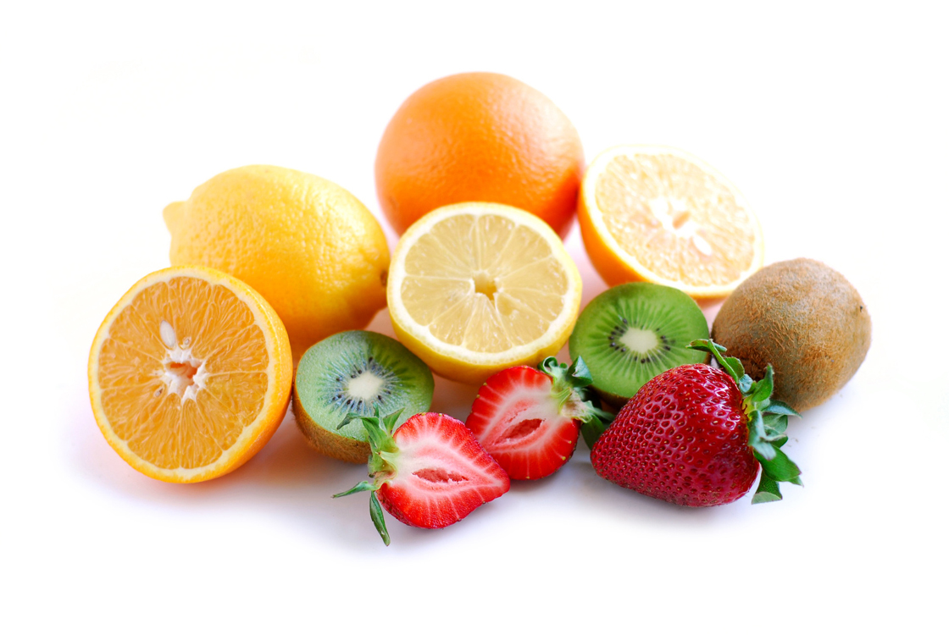
Fruits
Make most of your choices whole or cut-up fruit rather than juice, for the benefits dietary fiber provides.

Slide 19
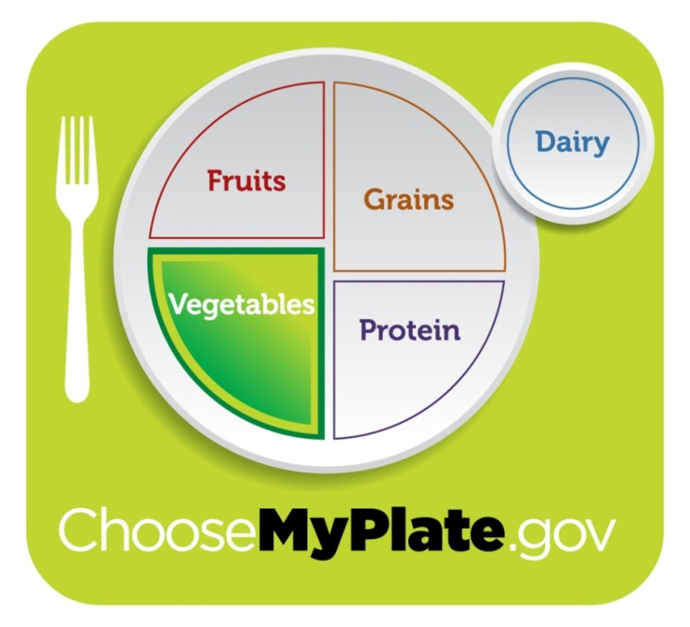
Vegetables
Eat 2½ cups of fresh, frozen, canned vegetables, or an equivalent amount of dried/dehydrated vegetables.*
* Based on a 2,000 - calorie daily food pattern for ages 19 and over;
amounts may vary depending on your calorie needs

Slide 20
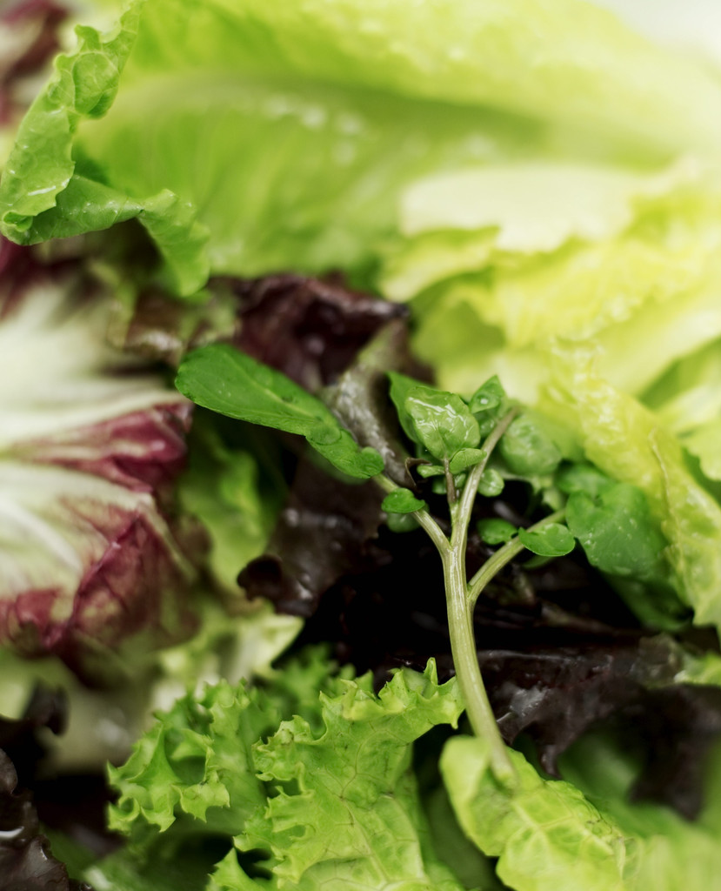

Vegetables
2 cups of raw leafy greens equal 1 cup of vegetables.

Slide 21
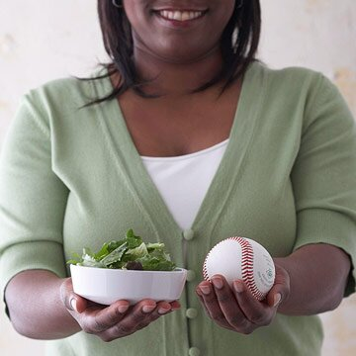
1 serving of salad

Slide 22
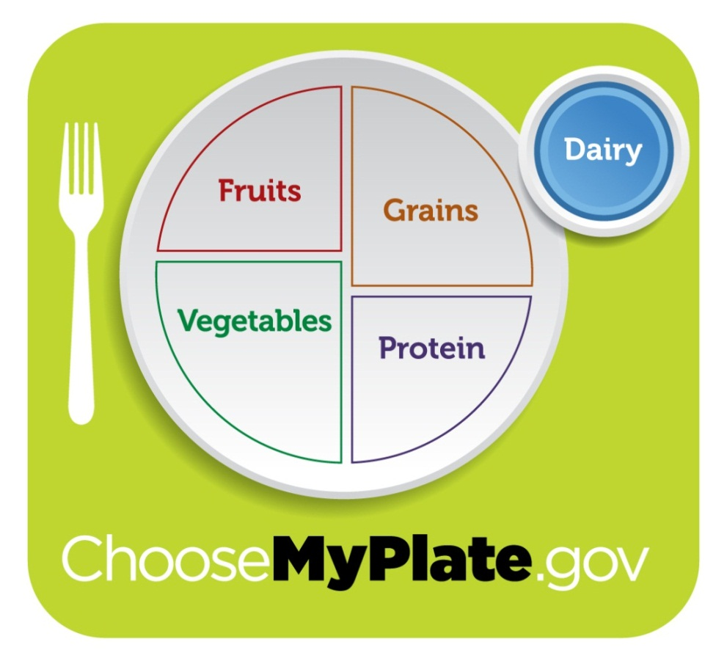
Dairy
Consume 3 cups
of fat-free or
low-fat milk (1%)
or equivalent
Dairy Group foods.*
* Based on a 2,000 - calorie daily food pattern for ages 19 and over;
amounts may vary depending on your calorie needs

Slide 23

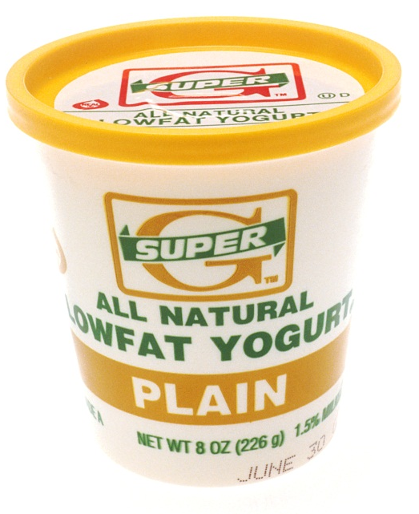
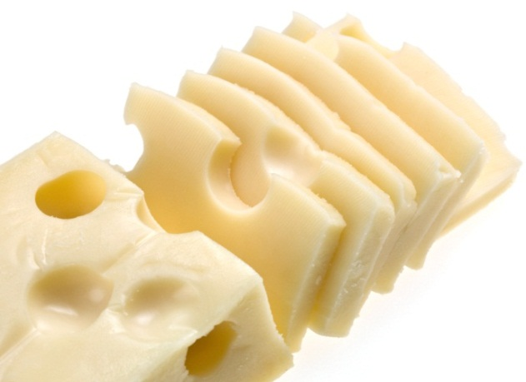
Dairy
1-cup dairy equivalents:
8 oz. milk (1 cup)
1 cup yogurt
1½ oz. natural cheese
2 oz. processed cheese
8 oz. calcium-fortified
soy beverages
Yogurt photo courtesy of National Cancer Institute, Renee Comet, photographer

Slide 24
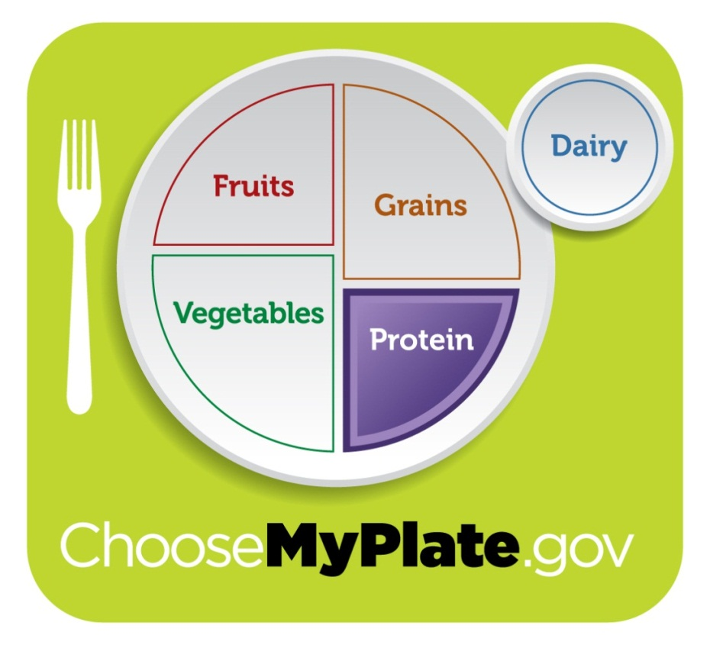
Protein
Eat 5½ oz.
(or equivalent)
of LEAN meat, poultry, or fish.*
* Based on a 2,000 - calorie daily food pattern for ages 19 and over;
amounts may vary depending on your calorie needs

Slide 25
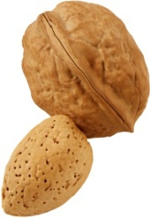
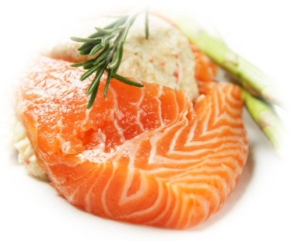
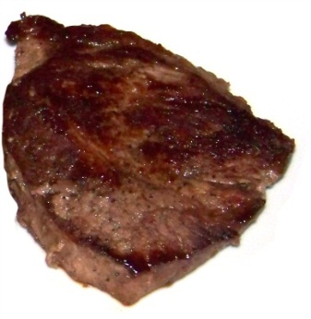
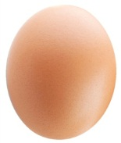
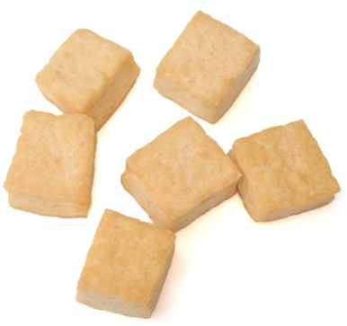
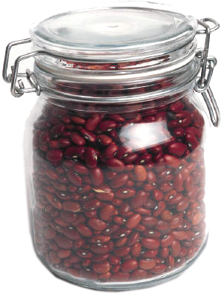
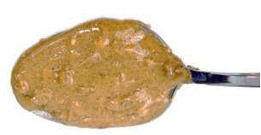
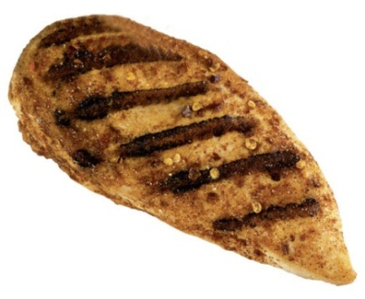
Protein
1-ounce meat equivalents:
1 oz. meat, poultry, or fish
¼ cup cooked beans or
peas (does not include
green beans and peas)
1 egg
1 tablespoon peanut or almond butter
½ oz. of nuts or seeds
¼ cup (about 2 oz.) of tofu
¼ cup roasted soybeans

Slide 26
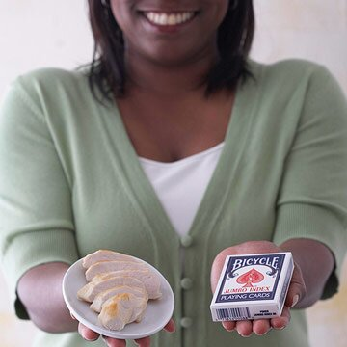
1 serving = 3 ounces

Slide 27
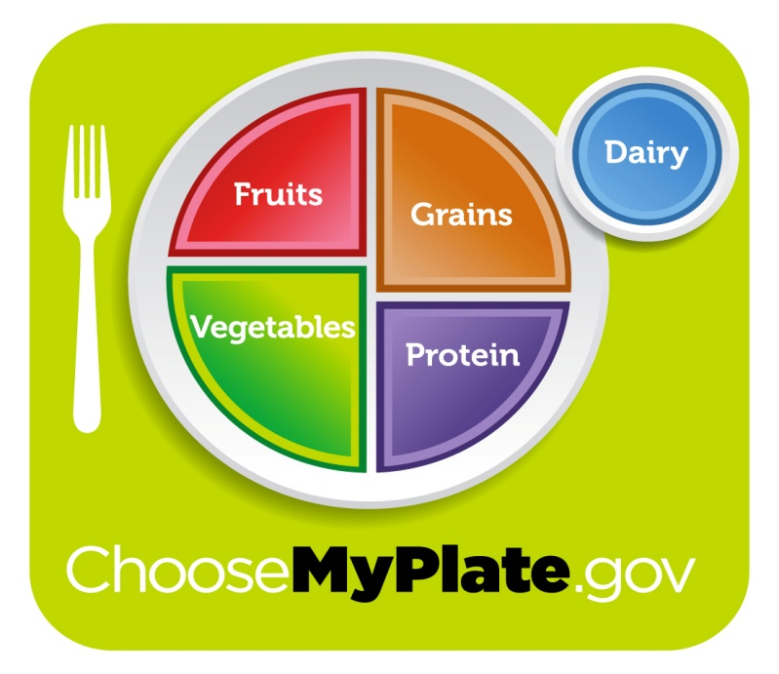
Key Messages of MyPlate
Make at least half your grains whole grains
Make half your plate fruits and vegetables
Switch to fat-free or low-fat (1%) milk
Balance calories:
Enjoy your food but eat less
Avoid over-sized portions
Reduce:
Sugary drinks by drinking more water
Sodium
Notes:
MyPlate has key messages for consumers. Review each of the food groups listed on the slide and the MyPlate key messages.
Selected messages for consumers:
Balancing calories:
Enjoy your food but eat less
Avoid oversized portions
Foods to Increase:
Make half your plate fruits and vegetables.
Make sure at least half your grains whole grains.
Switch to fat-free or low-fat (1%) milk.
Foods to reduce:
Compare sodium in foods like soup, bread, and frozen meals and choose the foods with lower numbers.
Drink water instead of sugary drinks

Slide 28
Limit Empty Calorie Foods
High in solid fats | Healthier choice
Regular ground beef (75% lean) | Extra lean ground beef (95% or more lean)
Fried chicken | Baked chicken (breast without skin)
Whole milk | Fat-free milk
Apple pie and ice cream | Fruit and yogurt parfait
Empty Calorie Foods: Foods with solid fats and/or added sugars but little nutritional value
Limit solid fats
  Eat less butter, stick margarine, shortening, lard
  Eat less cakes, cookies, pizza, hot dogs, sausages, ice-cream
  Choose baked, steamed, or broiled rather than fried
  Limit foods with partially hydrogenated oils
Notes:
MyPlate also recommends limiting empty calorie foods. Empty calorie foods are foods with solid fats and/or added sugars but with little nutritional value. To limit solid fats, you can encourage parents to (review slide)
Solid fats should be limited because they can increase your risk of heart disease. Oils on the other hand, provide essential nutrients important to heart health. Parents may misunderstand this message that healthy oils are healthy but we don’t want them to consume too much. Oils still have the same amount of calories as solid fats, so only small amounts of oils are recommended. It’s important for parents to understand that young children need healthy fats and oils for brain development, and providing the right type is key. Encourage parents to prepare food using vegetable oils like olive, canola, corn, safflower, or sunflower rather than solid fats. Soft margarines with zero trans fat made from liquid oils are preferable to stick margarine or butter. Encourage parents to use less butter, stick margarine, shortening and lard, and choose food preparation techniques like baking, steaming, or broiling instead of frying and limit foods made with partially hydrogenated oils.

Slide 29
Healthy Snacking
To provide a healthy, satisfying snack, aim to include a source of protein and fiber at each snack opportunity. Below are healthy snack ideas that are rich in protein and fiber:
Veggie sticks with hummus
Whole wheat pita bread slices with hummus
Banana topped with nut butter
Greek yogurt served with fruit
Cottage cheese topped with fruit or tomato slices
String cheese and strawberries
Apple slices served with a hard-boiled egg or a small handful of nuts
Cooked egg with a side of fruit
Whole grain crackers topped with turkey slices
Smoothie made from Greek yogurt, milk, frozen fruit and spinach leaves

Slide 30
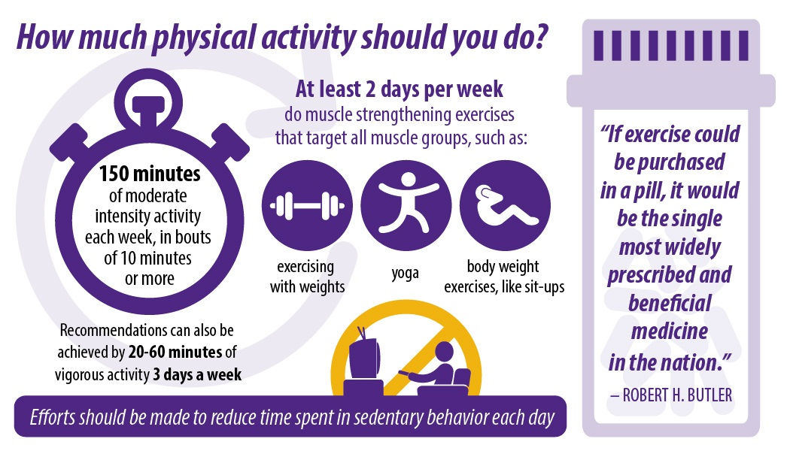
Get Moving!

Slide 31
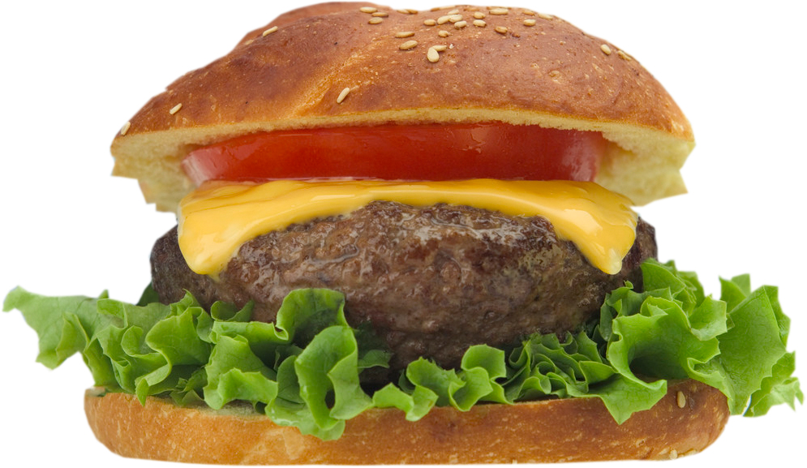
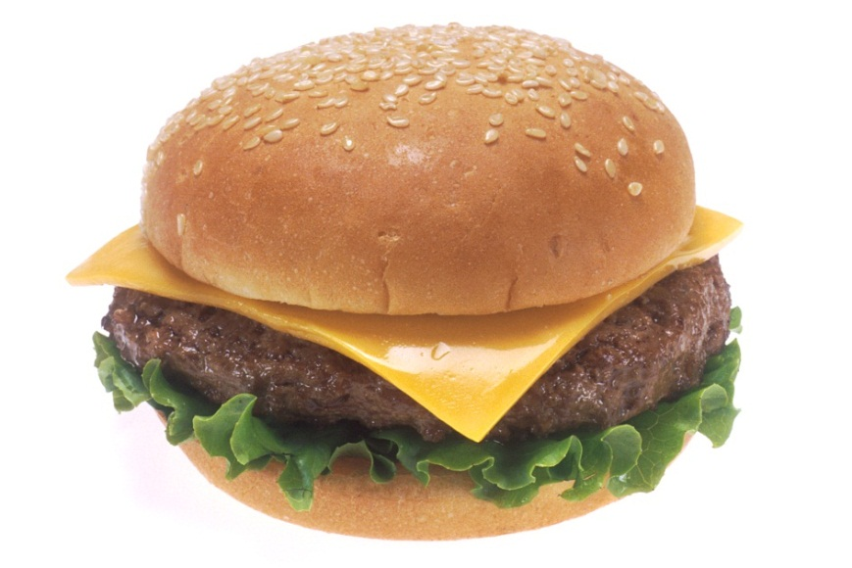
Guess the calorie difference!
20 Years Ago
Today

Slide 32
Guess the calorie difference!
333 calories
590 calories
257 more calories

Slide 33

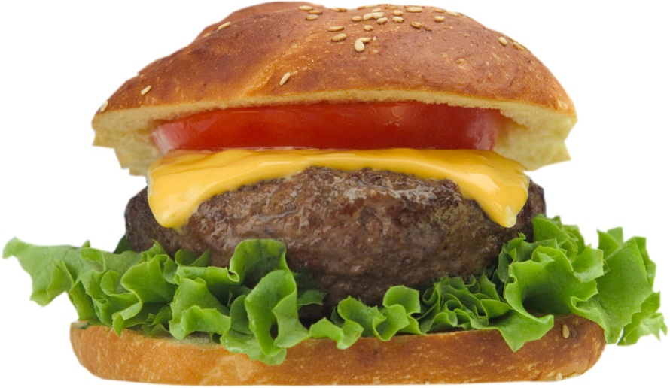
How long would you have to lift weights to burn 257 more calories?

Slide 34
How long would you have to lift weights to burn 257 more calories?
1 hour and 30 minutes
Based on 130-pound person

Slide 35
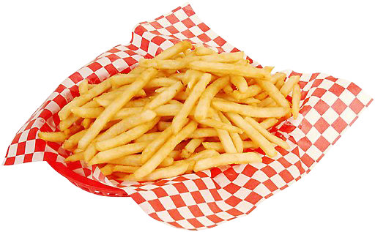
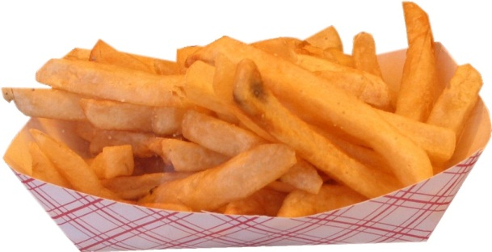
Guess the calorie difference!
20 Years Ago
Today
2.4 ounces
6.9 ounces

Slide 36
Guess the calorie difference!
210 calories
610 calories
400 more calories

Slide 37

How long would you have to walk leisurely to burn 400 more calories?

Slide 38
How long would you have to walk leisurely to burn 400 more calories?
1 hour and 10 minutes
Based on 160-pound person

Slide 39
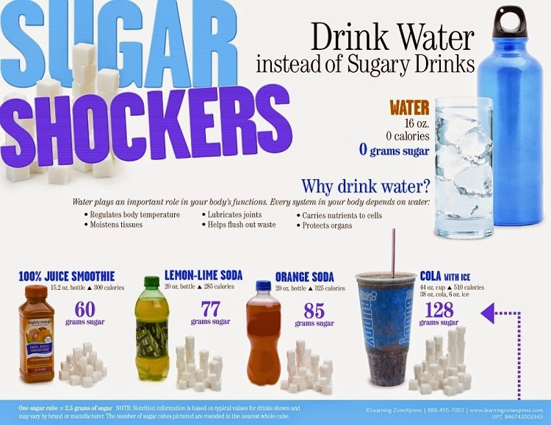
DRINK WATER

Slide 40
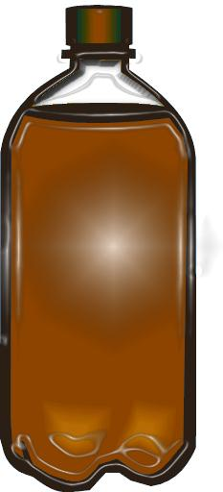
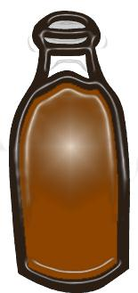
Guess the calorie difference!
20 Years Ago
Today
6.5-oz. soda
20-oz. soda

Slide 41
Guess the calorie difference!
85 calories
250 calories
165 more calories

Slide 42

Keep an “eye” on your food portion sizes

Slide 43
References
Choose MyPlate at http://ChooseMyPlate.gov
Alice Henneman and Amy Peterson University of Nebraska-Lincoln Cooperative Extension “Prevent Portion Distortion” https://food.unl.edu/fnh/portiondistortion

Slide 44
Contact Information
Meredith Evans MS, RD, LD
310 Whittington Parkway Suite 200
Louisville, KY 40222
Phone: 502-429-4430 Ext . 2082
Toll Free: (800) 232-1160 Ext. 2082

